Slide 2
Intro
In graph theory, labeling is used to assign strings or numbers to each vertex, edge or both of the graph in order to make them each distinguishable. However, there is a more refined version of this known as graph coloring.

Slide 3
Graph coloring
Graph coloring assigns each vertex, edge or both a color according to a set of rules. The most common rule is that no two adjacent edges are the same color.

Slide 4
Project goal
In this project, we are going to focus exclusively on edge coloring and more accurately, the edge chromatic number which is the least amount of unique colors it takes to color every edge of the graph.
Our algorithm will take a graph as an input and output the edge chromatic number.

Slide 5
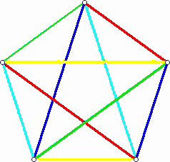
Example 1
This k₅ graph takes a total of 5 different colors to fully color the graph.
K₅ Graph

Slide 6
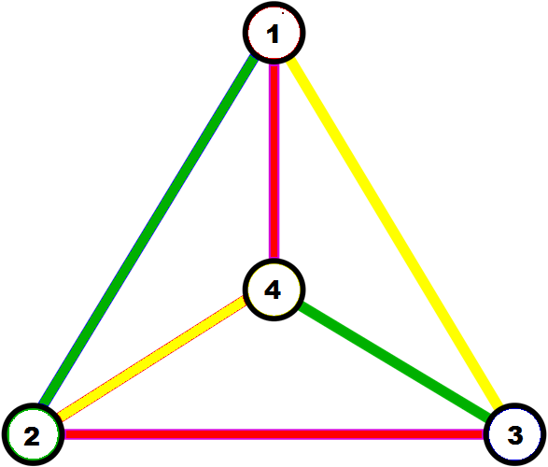
Example 2
You can use an edge coloring to schedule a round robin tournament. The edge chromatic number is the lowest number of rounds that must be given.
Rounds = 3
 | 1 | 2 | 3 | 4
1
2
3
4
ECN = 3

